Slide 1
TECHNICAL ARCHITECTURE DECK
AI Blog Nest API
Enterprise-Grade Autonomous Content Generation Engine Powered by NestJS & OpenAI
FRAMEWORK
AI SDK
DATABASE
NestJS v10
OpenAI GPT-4o API
PostgreSQL + Prisma

Slide 2
EXECUTIVE SUMMARY
Autonomous Content Generation Platform
10x
Streamed LLM Responses
Server-Sent Events for real-time article drafting feedback.
Enterprise Security
Publishing Speed
JWT authentication, rate limits, and request throttling.
Automated blog ideation, SEO tagging, structured formatting, and instant AI publishing.
Modular Architecture
NestJS dependency injection and domain boundary isolation.

Slide 3

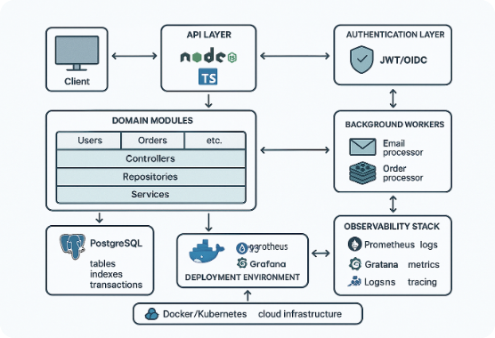
SYSTEM TOPOLOGY
High-Level System Architecture
GATEWAY
REST Controller Layer
Validates DTO payloads and guards endpoints with JWT tokens.
CORE LOGIC
AI Domain Services
Constructs prompt trees and manages async BullMQ jobs.
PERSISTENCE
PostgreSQL & Redis
Stores structured posts, user usage quotas, and cache keys.

Slide 4
CORE STRUCTURE
NestJS Module Decomposition
Auth Module
AI Generator Module
Blog Posts Module
Handles user registration, login, bcrypt password hashing, and Passport JWT strategy validation.
Encapsulates OpenAI SDK calls, prompt template engines, and streaming response handlers.
Manages article CRUD, tag associations, status publishing states, and pagination queries.

Slide 5




TECHNOLOGY ECOSYSTEM
Production Dependencies
TypeScript & NestJS
Vercel AI SDK
Prisma ORM
BullMQ & Redis
Strict type safety and decorator metadata injection.
Unified streaming protocols for LLM output.
Auto-generated DB client with type-safe schema.
Asynchronous background job queue management.

Slide 6
SECURITY & CONTROLS
Authentication & Access Control
JWT Access Pipeline
API Rate Limiting
Stateless Auth: Bearer tokens issued on successful auth.
Throttler Module: Max 10 AI generation calls per minute.
Custom Guards: @UseGuards(JwtAuthGuard) decorates endpoints.
Token Quotas: Daily user limit tracking stored in Redis.
RBAC Controls: Admin and Author role-based permissions.
Header Injection: Expresses remaining allowance limits.

Slide 7
WORKFLOW PIPELINE
AI Article Generation Lifecycle
STEP 01
STEP 02
STEP 03
STEP 04
Prompt Request
Outline Assembly
Stream Drafting
Persist Draft
User submits article topic, tone, target length, and key terms.
System builds structured JSON outline with heading hierarchies.
OpenAI stream produces Markdown body text via SSE protocol.
Final post saved to database as editable draft entity.

Slide 8
INTERFACE SPECIFICATION
Core API Routes
METHOD | ENDPOINT | DESCRIPTION | AUTH REQUIRED
POST | /api/v1/auth/login | Authenticates user & returns JWT | Public
POST | /api/v1/ai/generate | Triggers AI blog creation engine | Bearer Token
GET | /api/v1/posts | Fetches paginated published posts | Public
DELETE | /api/v1/posts/:id | Removes article by ID | Admin Token

Slide 9
DATA PERSISTENCE
Post Entity Schema
model Post {
id String @id @default(uuid())
Unique Slugs
title String
Automatically derived from AI title with collision handling.
slug String @unique
content String @db.Text
status PostStatus @default(DRAFT)
authorId String
Draft States
createdAt DateTime @default(now())
Enum flags: DRAFT, REVIEW, PUBLISHED, ARCHIVED.
}

Slide 10
DATA MODELS
User & Audit Entities
User Schema
AI Request Log Schema
Tag & Category Schema
Stores password credentials, roles, token quotas, and active subscription tier flags.
Tracks prompt history, completion tokens, latency stats, and execution cost metrics.
Many-to-many post relations for taxonomy search and SEO indexing.

Slide 11
AUTOMATION ENGINE
Phase 1: Topic Ideation & Outline
Keyword Extraction
Section Tree
SEO Intent Match
Parses user seed input into key entities.
Generates H2 and H3 heading outlines.
Ensures search intent criteria fulfillment.

Slide 12
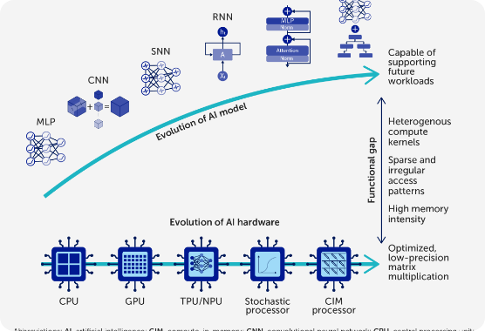
GENERATION ENGINE
Phase 2: Full Article Drafting
Contextual Prompt Assembly
Injects target persona and brand guidelines.
Token-by-Token Streaming
Reduces latency perception using SSE streams.
Markdown Standardizer
Sanitizes AI raw markdown into safe HTML blocks.

Slide 13
OPTIMIZATION
Automated SEO Metadata Service
160
100%
5-8
Char Meta Summary
OpenGraph Ready
Taxonomy Tags
Auto-generated description snippet.
OG title, tags, and twitter card metadata.
Extracts high-intent category tags.

Slide 14
VISUAL ASSETS
Featured Image Prompt Synthesis
Prompt Distillation
DALL-E Integration
S3 CDN Persistence
Extracts core subject metaphor from article text.
Fires async generation call to image endpoints.
Downloads image asset and stores to Cloud CDN.

Slide 15
CODE DESIGN
NestJS Controller Pattern
@Controller('ai')
@UseGuards(JwtAuthGuard)
Decorator Syntax
export class AiController {
Clean routing and guard declaration.
constructor(private aiService: AiService) {}
@Post('generate')
async generate(@Body() dto: GenerateBlogDto) {
DTO Validation
return this.aiService.createArticle(dto);
Automatic payload type validation.
}
}

Slide 16
BUSINESS LOGIC
AI Generation Service Injection
@Injectable()
export class AiService {
Prisma Binding
constructor(private prisma: PrismaService) {}
Direct database write upon completion.
async createArticle(dto: GenerateBlogDto) {
const prompt = this.buildPrompt(dto);
const response = await openai.chat.completions.create({...});
Service Isolation
return this.prisma.post.create({...});
Keeps HTTP handlers clean and reusable.
}
}

Slide 17


REAL-TIME INTERACTION
Server-Sent Events Streaming
SSE Controller Endpoint
Zero Latency Delay
Uses Observable to pipe active OpenAI token chunks straight to frontend clients.
Users start reading the first paragraph within 200ms rather than waiting 15 seconds for full synthesis.

Slide 18
RESOURCE PROTECTION
Throttling & Quota Policies
10 / min
50 k
HTTP 429
Standard Burst Limit
Daily Token Ceiling
Graceful Throttle Error
Prevents API endpoint abuse.
Enforced per user subscription tier.
Standardized payload response.

Slide 19
INPUT VALIDATION
Data Transfer Objects (DTOs)
Class-Validator
Class-Transformer
Swagger Decorators
Decorators like @IsString() and @MinLength() enforce payload contract.
Pipelined sanitization strips unallowed attributes automatically.
@ApiProperty() auto-generates live interactive OpenAPI specs.

Slide 20
PERFORMANCE OPTIMIZATION
Redis Caching Layer
Query Cache Strategy
LLM Prompt Memoization
Read Acceleration: Public post feeds cached in Redis memory.
Hashed Prompts: Identical requests reuse token outputs.
TTL Invalidations: Cache flushed automatically upon post updates.
Cost Reduction: Cuts redundant third-party API expense.
Latency Cut: Response time drops from 120ms to 8ms.
Fallback Store: Graceful degradation on model downtime.

Slide 21
ASYNC PROCESSING
BullMQ Queue Architecture
QUEUE 01
QUEUE 02
QUEUE 03
Job Producer
Redis Worker
Event Emission
API receives bulk blog generation request and dispatches job.
Worker picks job, executes LLM call with exponential retry policies.
Emits completion event to notify user via webhooks.

Slide 22
RELIABILITY
Global Exception Handling
Custom Filters
OpenAI Fallback
Audit Tracing
Catch unhandled exceptions and format clean JSON error payloads.
Graceful model switching on API error rate spikes.
Integrates with Sentry for centralized error monitoring tracking.

Slide 23
INTEGRATION
Event-Driven Webhook Pipeline
Internal Events
Outbound Webhooks
post.created: Triggers background notification system.
CMS Sync: Dispatches new articles directly to WordPress/Ghost.
ai.completed: Logs token consumption to billing engine.
HMAC Signature: Secures payload integrity for receivers.

Slide 24
DEVELOPER EXPERIENCE
Automated OpenAPI Specifications
Interactive UI
Bearer Token Testing
Client SDK Export
Interactive testing portal exposed at /api/docs.
Built-in authorization button for JWT testing.
Auto-generates TypeScript client SDKs from OpenAPI JSON.

Slide 25
QUALITY ASSURANCE
Unit & Integration Testing
Jest Unit Tests
Supertest E2E Suite
Mocking: OpenAI SDK completely mocked in unit execution.
Real Pipeline: Tests full HTTP requests with test DB container.
Coverage Target: Over 85% core business domain coverage.
Auth Flows: Verifies token lifecycle and guard rejection.

Slide 26
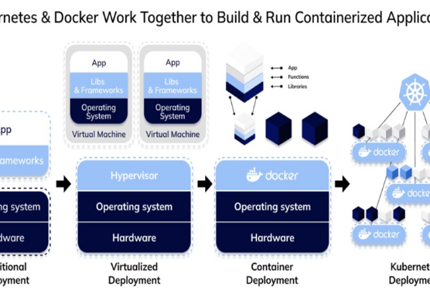
DEPLOYMENT
Containerized Stack
Multi-Stage Dockerfile
Slim Alpine base image producing sub-150MB builds.
Docker Compose Stack
Orchestrates API, Postgres, and Redis locally with one command.

Slide 27
CONTINUOUS DELIVERY
GitHub Actions Release Pipeline
STAGE 01
STAGE 02
STAGE 03
STAGE 04
Lint & Audit
Execute Tests
Build Image
Rolling Deploy
Runs ESLint and security dependency scans.
Fires Jest unit and Supertest e2e checks.
Pushes tagged image to AWS ECR registry.
Zero-downtime deployment to Kubernetes cluster.

Slide 28
BENCHMARKS
Production Performance Indicators
< 15ms
99.9%
2.5k
200ms
Cached API Latency
Service Uptime
Req / Sec Capacity
Stream TTFB

Slide 29
FUTURE VISION
Engineering Roadmap
Q3 2026: Multi-LLM
Q4 2026: RAG Search
Q1 2027: Fine-Tuning
Integrates Anthropic Claude and open-source Llama 3 models for cost arbitrage.
Vector database integration (pgvector) for accurate custom document grounding.
Automated fine-tuning pipeline on high-performing user blog posts.

Slide 30

AI Blog Nest API Complete
Production-ready NestJS architecture for enterprise autonomous blogging.
github.com/ai-blog-nest-api
docs.aiblognest.io

Slide 31



Image Sources
https://miro.medium.com/v2/resize:fit:1400/1*tdfR5-SDkIAgZcaodCideQ.png
Source: medium.com
https://www.frontiersin.org/files/Articles/1611658/xml-images/fsci-03-1611658-g001.webp
Source: www.frontiersin.org
https://miro.medium.com/1*6ifp6-xFc6rPXfS-vFemag.png
Source: medium.com

